Slide 1
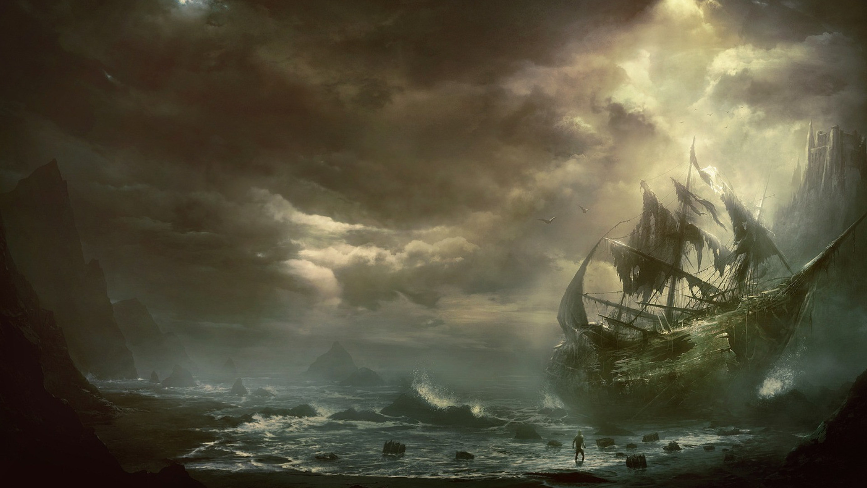


Splendor
Edward Chen, Jacky Lin, Wenyi Qian, Yili Wang

Slide 2
Outline
What is Splendor？
Design and Implementation
User Interface
Scrum Experience

Slide 3

How to play Splendor?
Cards
Gem tokens
Prestige Points
Nobel cards

Slide 4
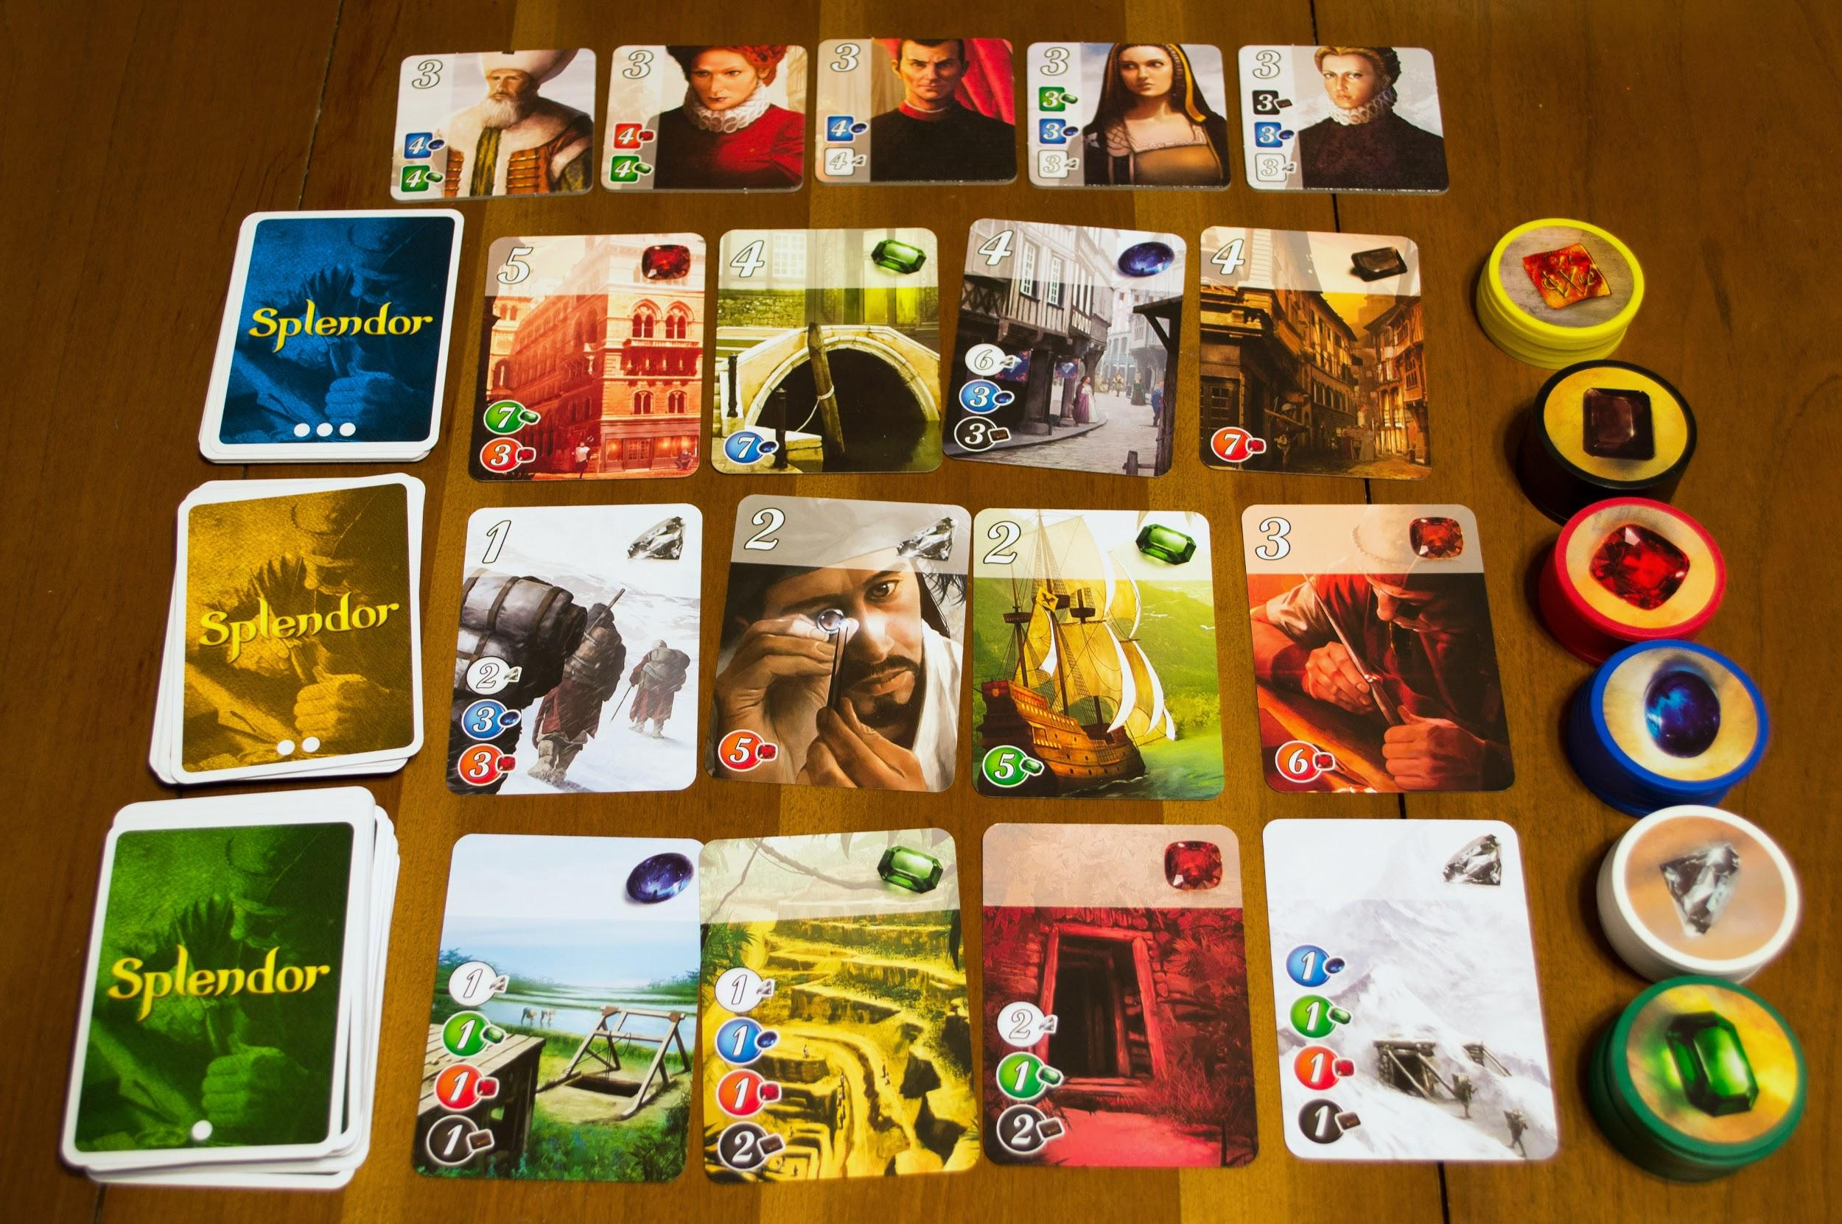

Slide 5
Design and Implementation

Slide 6
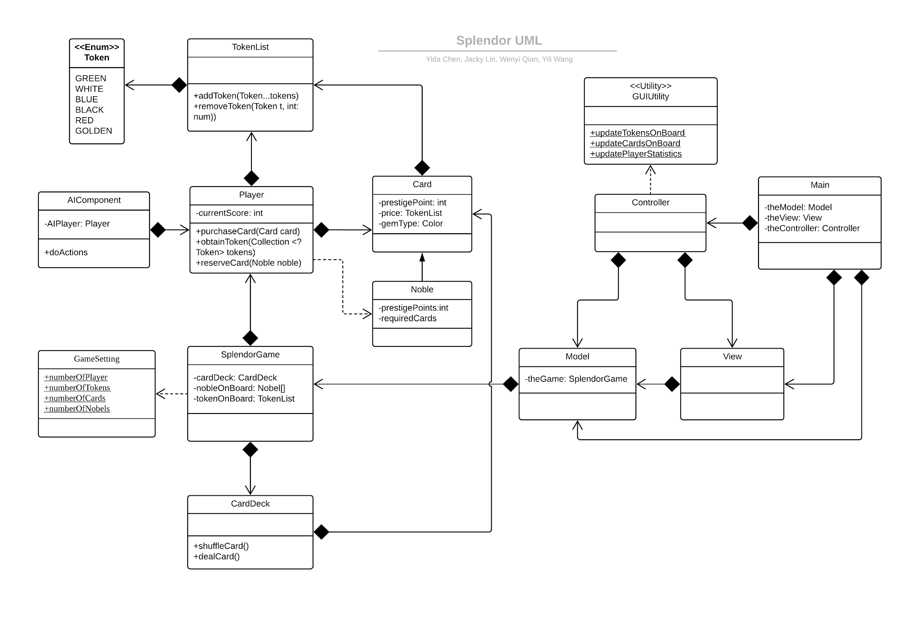
Notes:
We have a special customized data structure. It is designed for restore the token number of each kind and compare with one another. I created it based on the hashtable, where you can add and look up a token color in a fast way. I also provides multiple overridden method of insert token into the tokenlist.
AI component is a very fundamental ai that allows ai player to play with the users. It analyses situations on the board, and do actions just like a user can do.

Slide 7
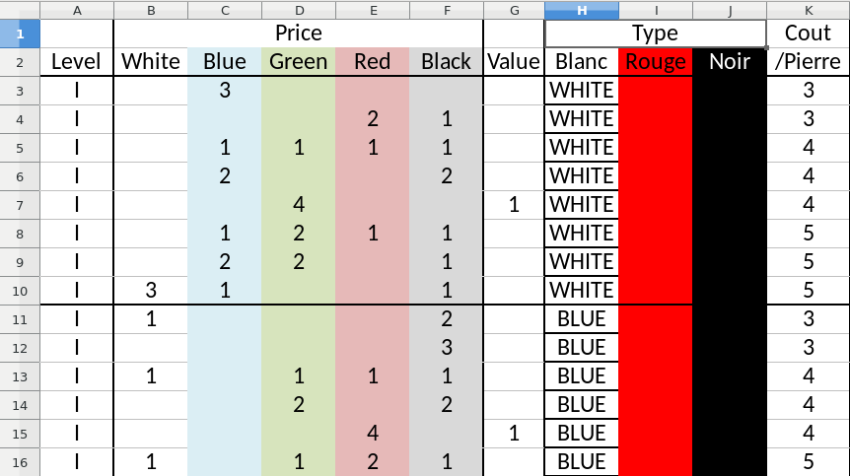
CSV File

Slide 8
User Interface & Software

Slide 9
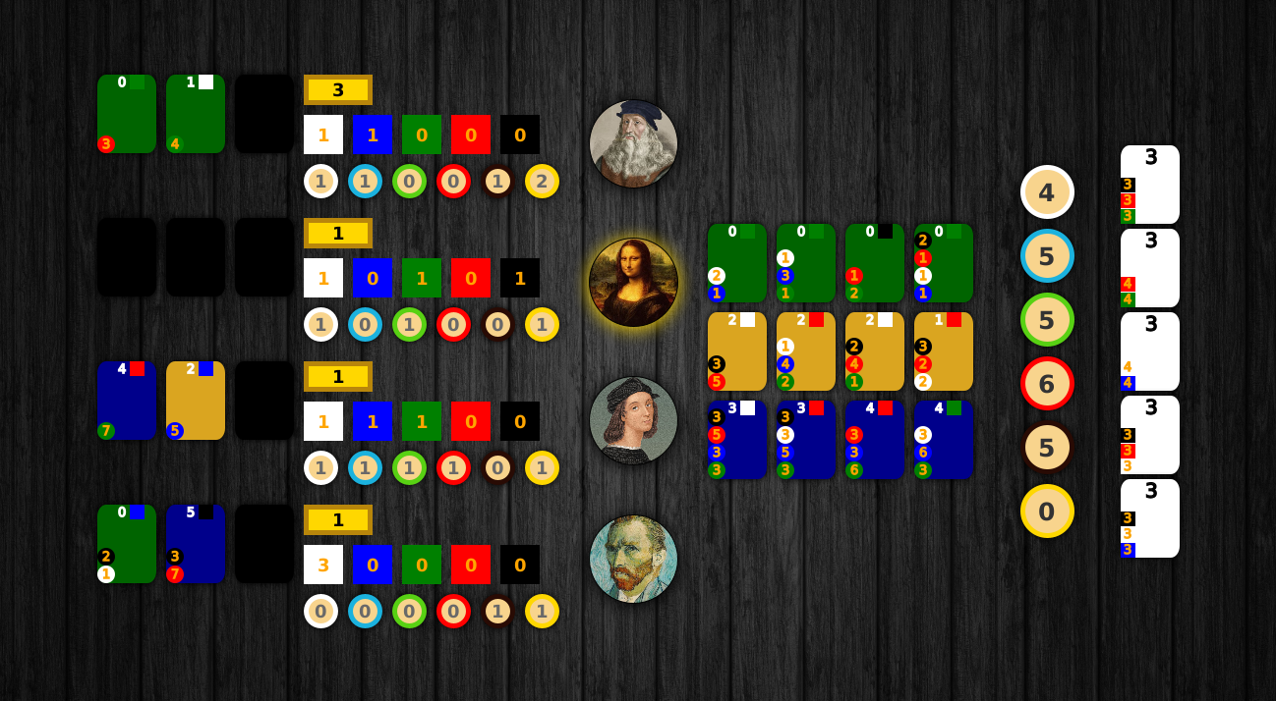
User Interface

Slide 10
Scrum Experience

Slide 11
Timeline
Sprint 1
Basic GUI & Components
Sprint 2
MVC Design & Basic AI
Sprint 3 ~ TODAY
Advanced AI
Sprint 4 Game Configuration & Refactor
Read Card Info
Implement the Card Deck class
Make basic GUI View
Test the functions
Add Basic AI
Implement Controller & Model
Beautify GUI
Debug and upgrade AI
Add more strategies for AI
In-Game Configuration
Refactor and handle exception

Slide 12
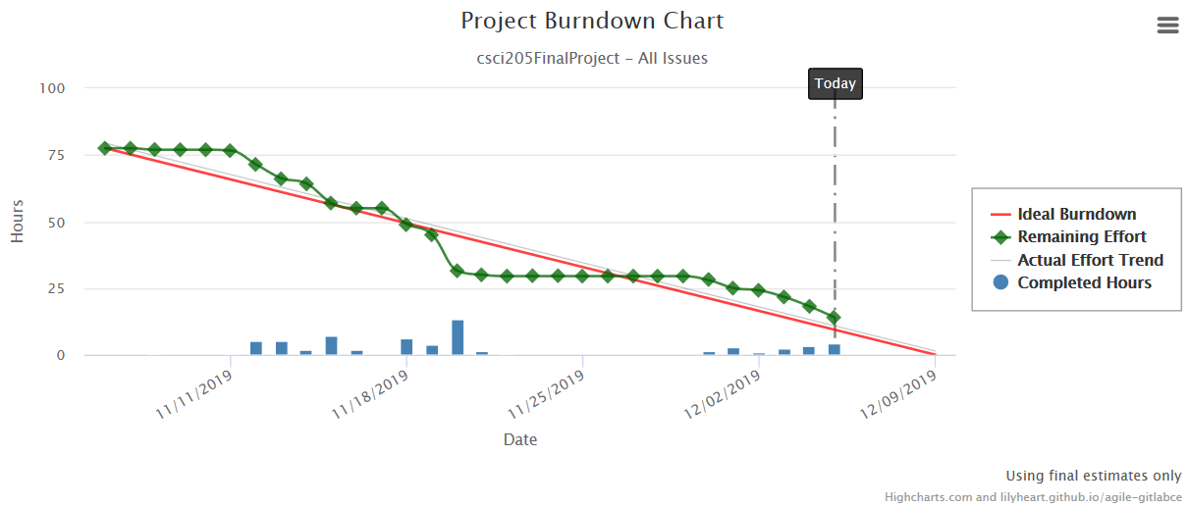
Scrum Burn Down

Slide 13
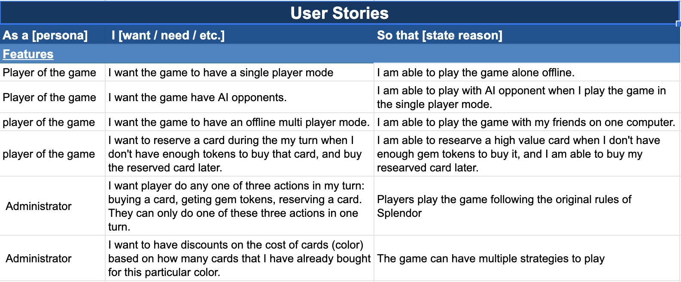
User stories
https://docs.google.com/spreadsheets/d/1mANG19Gu17vG_HYuWcHw_2chGZJULcDM-QAOAgmHaaY/edit#gid=0

Slide 14
Strengths & Weaknesses
Strengths:
Good time management for project
Active attitude; always on a good track
Effective communication
Well refactored codes
Weakness:
Unclear task assignment: some repetitive work
Naming and Javadoc are not very clear sometime
Spending substantial time on learning the functionality of the others’ codes

Slide 15
What next?
Online multiplayer
Account System
Smarter AI

Slide 16

?

Slide 17
References
<Oracle> JavaFx Alert https://docs.oracle.com/javase/8/javafx/api/javafx/scene/control/Alert.html
<Kodejava> Store objects in file https://kodejava.org/how-do-i-store-objects-in-file/
<Board Game Geek>Splendor csv file https://boardgamegeek.com/filepage/136731/full-splendor-card-list-wpics
<Biography> Player Icons
https://www.biography.com/.image/ar_1:1%2Cc_fill%2Ccs_srgb%2Cg_face%2Cq_auto:good%2Cw300/MTY2MzU4MjUzMDA4MDcwMzE4/portrait-of-leonardo-da-vinci-1452-1519-getty.jpg
https://www.biography.com/.image/t_share/MTE5NTU2MzE1OTY2NDQwOTcx/raphael-41051-1-402.jpg
https://www.biography.com/.image/ar_1:1%2Cc_fill%2Ccs_srgb%2Cg_face%2Cq_auto:good%2Cw_300/"+"MTY2NTIzMzc4MTI2MDM4MjM5/vincent_van_gogh_self_portrait_painting_musee_dorsay_via_wikimedia_"+"commons_promojpg.jpg
<Masterpiece> Player Icon
https://masterpieces-of-art.com/wp-content/uploads/2014/08/mona-lisa-leonardo-da-vinci-e1427514342170-520x520.jpgg

